Slide 1
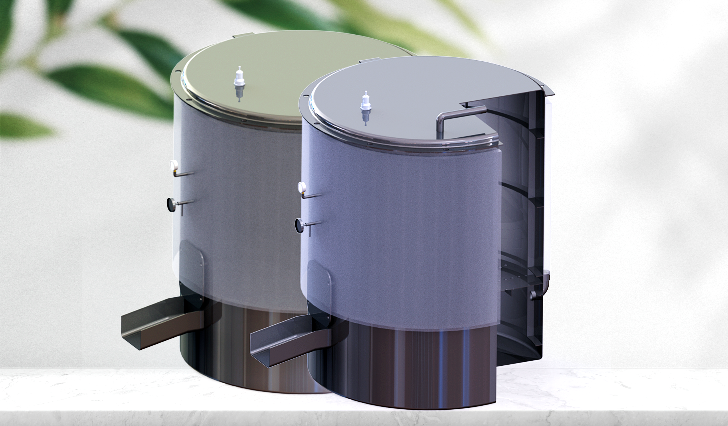

STERILIZATION - UNIT
AUTOCLAVE
© Chowdhury Raihan Uddin
© Nazib Eadin
© Raad Shahmat Haque
© Shuhail Ragib

Slide 2
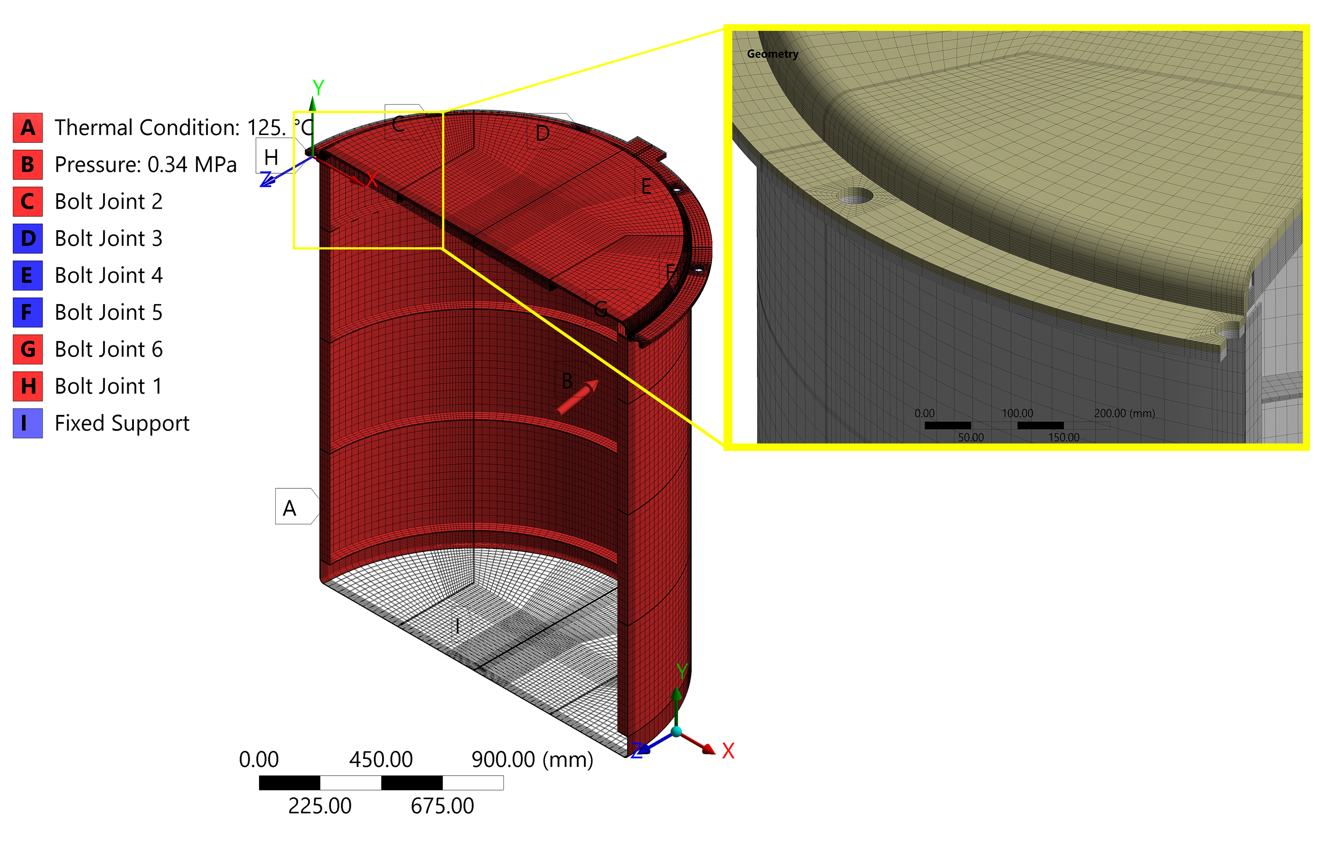
Structural Integrity & Fatigue Assessment as per the ASME
Safety Requirements
Insulation
Temperature Controller
Pressure Relief Valve
High Pressure Alarm System
SCL Name | SCL Location | P_{l}, MPa |  | P_{l}+P_{b}+Q, MPa |  | Remark as per ASME
 |  | Actual | Allowable | Actual | Allowable
SCL 1 | Lid knuckle | 48.94 | 160.8 | 255.77 | 321.6 | Acceptable
SCL 2 | Shell knuckle | 80.914 | 160.8 | 291.49 | 321.6 | Acceptable
SCL 3 | Lid cross-section | 119.5 | 160.8 | 232.04 | 321.6 | Acceptable
SCL 4 | Shell cross-section | 132.64 | 160.8 | 150.78 | 321.6 | Acceptable
Approx. 10,000
Design Cycles

